Slide 1
Lecture 12

Slide 2
Question 223.14.1
To the left is a photo of several light beams. Is the light traveling
from the right to the left
From the left to the right
Can’t tell

Slide 3
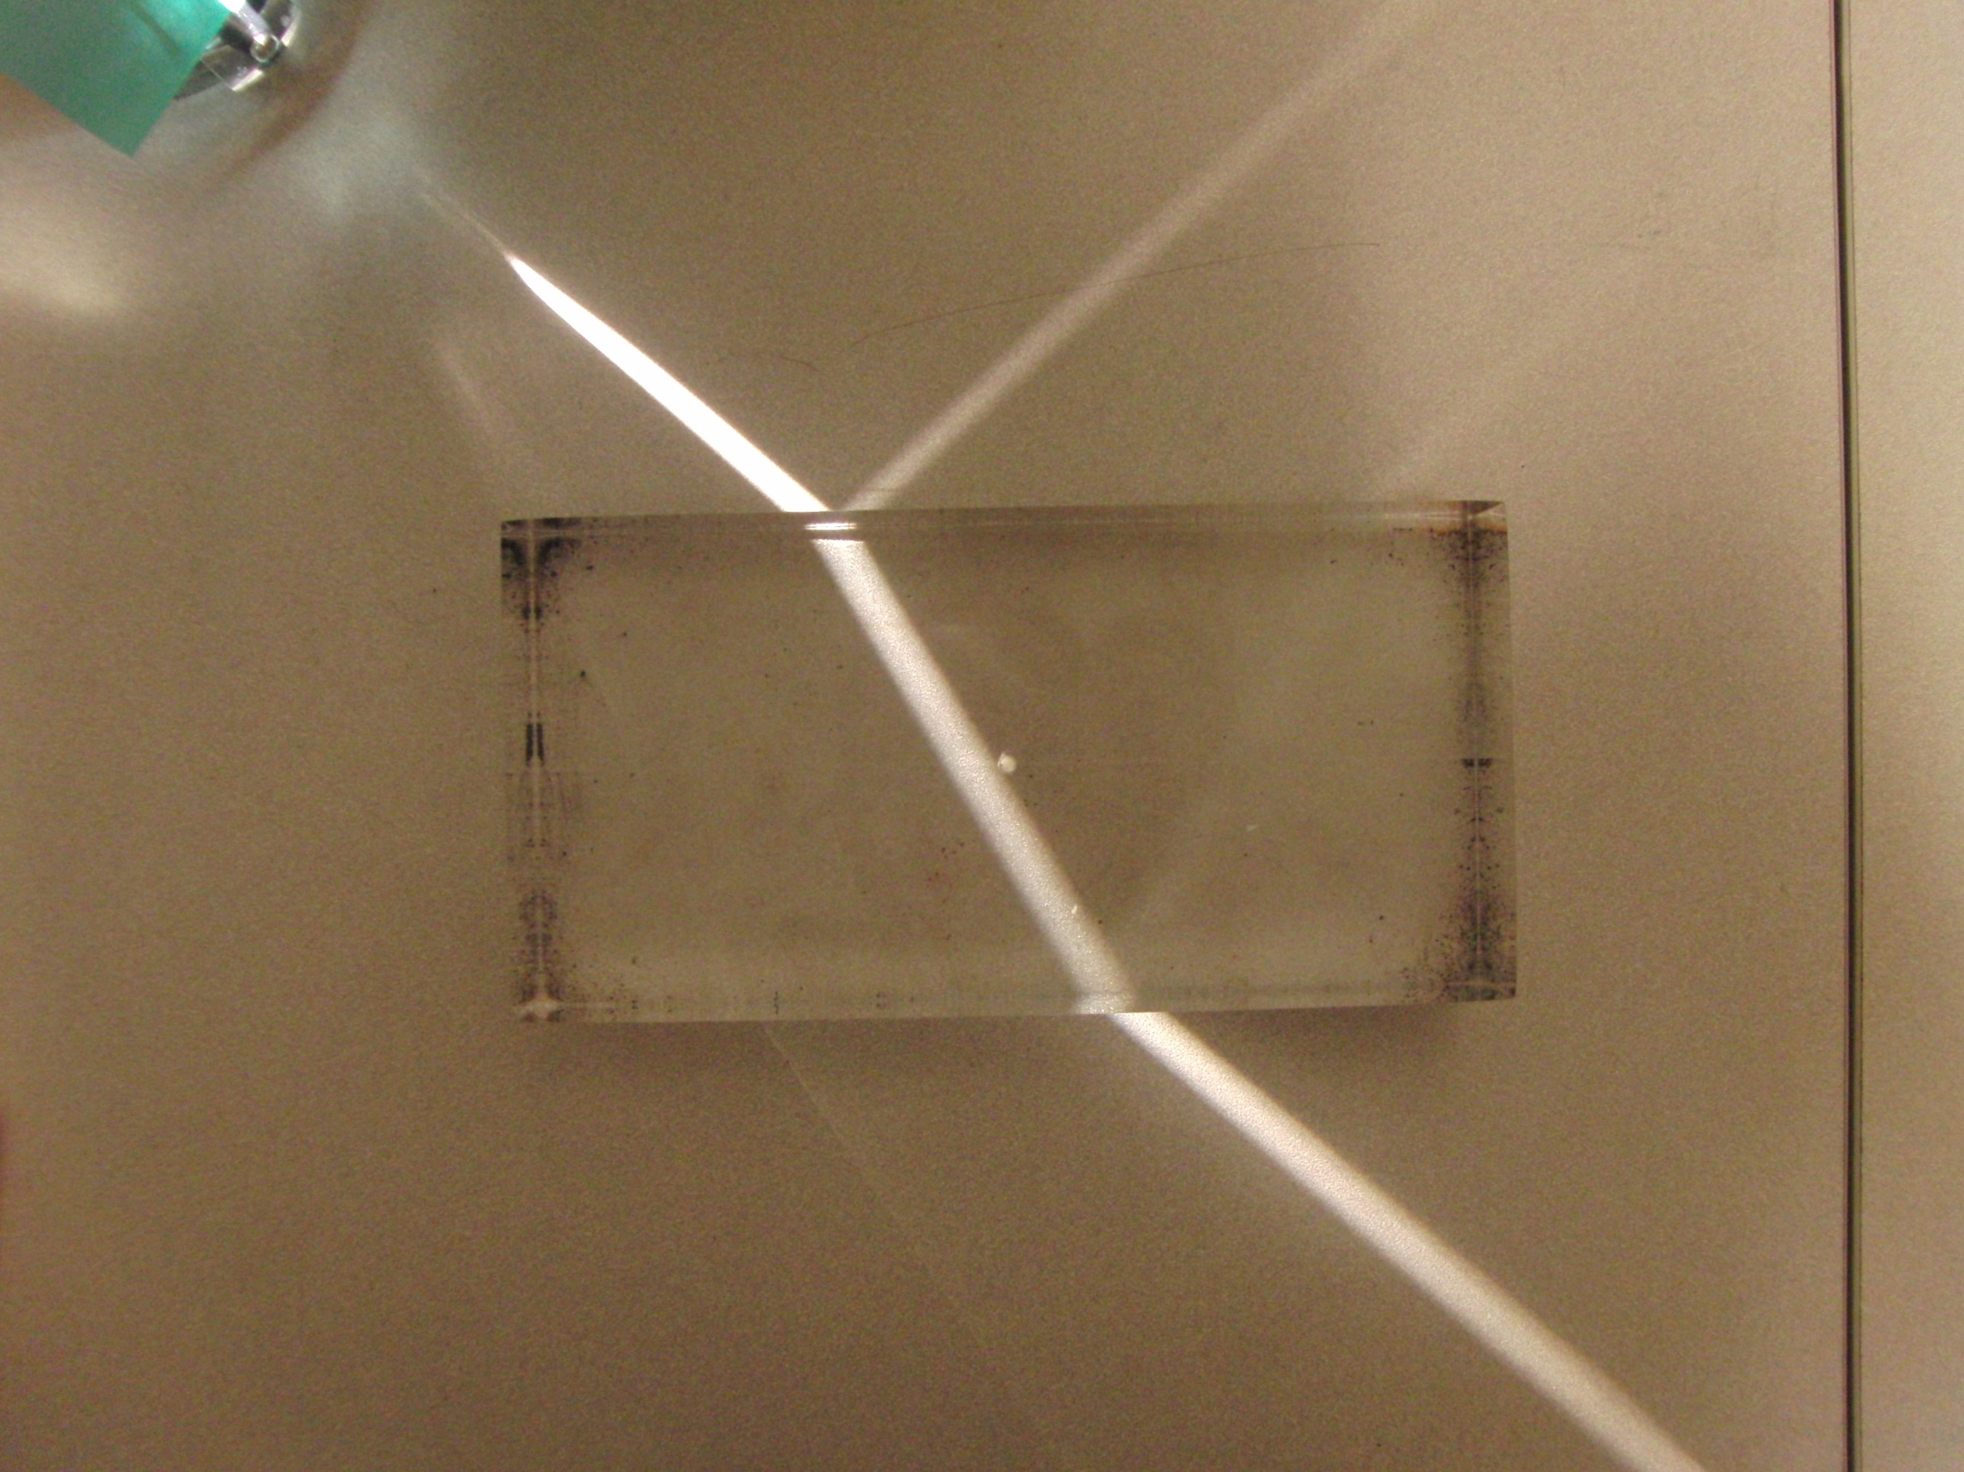

Slide 4
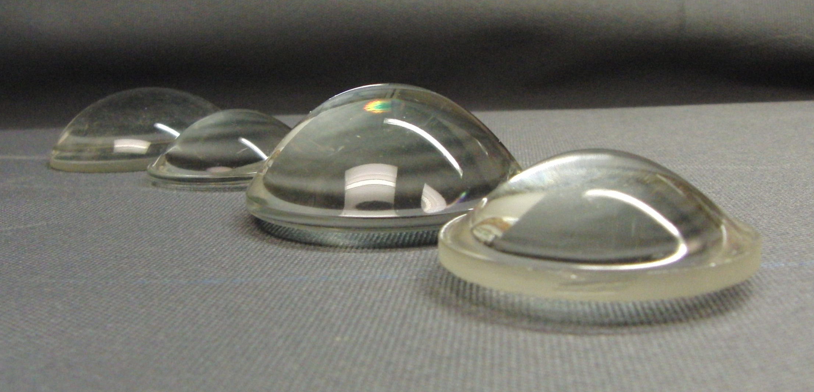

Slide 5
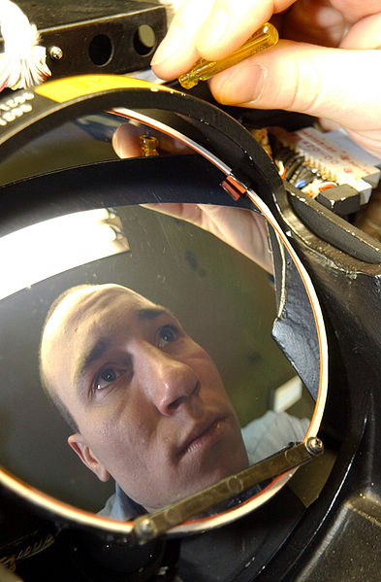

Slide 6
Question 223.14.1.5
We have found that when a wave enters a material, its speed may change. But we remember from wave theory v=λf But it is time to review: does λ change, or does f change? Wavelength
Frequency
Both
Can’t tell

Slide 7
Question 233.14.2
Suppose we have a material with an index of refraction of 2. What is the speed of the light in this material?
c/2
c/4
2c
4c
Can’t tell

Slide 8
Incident Ray
Reflected Ray
θ₁
θ₃
Air
Fast
n₁ (Small)
Glass
Slow
n₂ (Large)
θ₂
Transmitted Ray

Slide 9
Incident Ray
Reflected Ray
θ_{i}
θ_{r}
Air
Fast
n_{i} (Small)
Glass
Slow
n_{t} (Large)
θ_{t}
Transmitted Ray

Slide 11
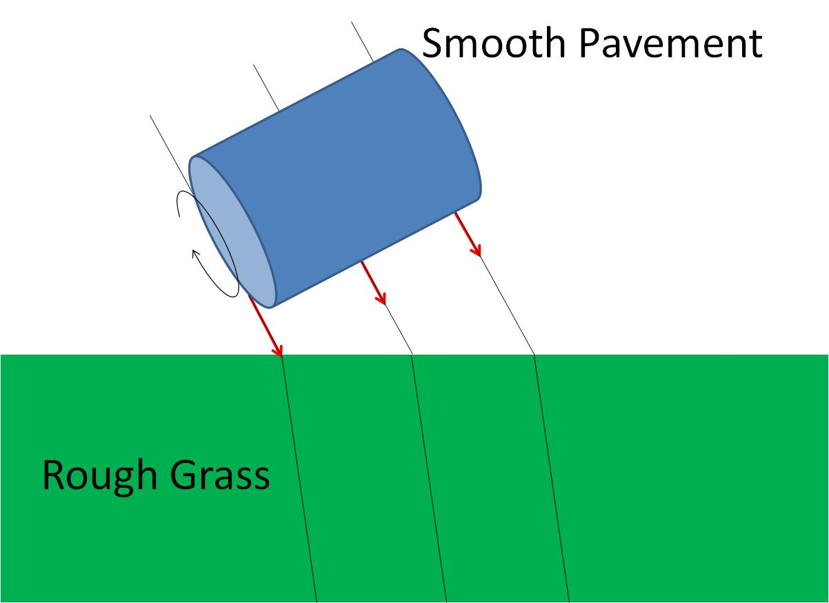
Smooth Pavement
Rough Grass

Slide 12
Smooth Pavement
Rough Grass

Slide 13
Smooth Pavement
Rough Grass

Slide 14
θ_{i}
θ_{t}

Slide 15
θ
φ

Slide 16
Question 223.14.3
Light passes from a material with index of refraction 1.3 into one with index of refraction 1.2. Compared to the incident ray, the refracted ray
bends toward the normal
is undeflected
bends away from the normal

Slide 17
Question 223.14.5.5
The index of refraction of the Lucite block is 1.4. The angle θ_{i} = 20°. What is θ_{t}?
14. 14 °
0. 247 °
0.499 °
28. 61 °
θ_{i}
θ_{t}

Slide 19
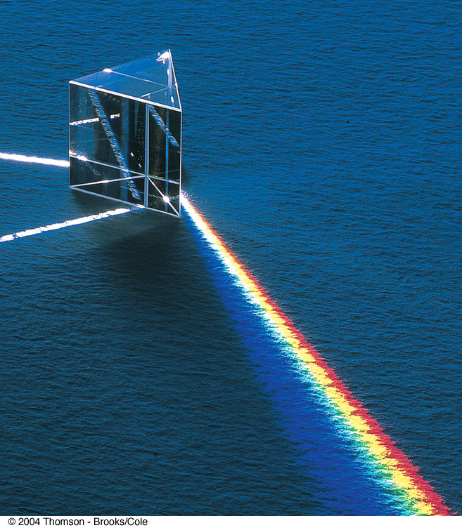
Question 223.14.6
In the picture to the right, there is a input white light ray, and a dispersed set of rays. There is another white ray. Why might that be?
It took two rays of white light to make the rainbow bright enough.
It is an optical illusion, it is not really there
It is due to internal reflection
It is the refracted ray leaving the prism.

Slide 20
Transmitted Ray
θ_{t}
Air
Fast
n_{t} (Small)
Glass
Slow
n_{i} (Large)
θ_{i}
θ_{r}
Incident Ray
Reflected Ray

Slide 21
Question 223.14.5
As light from the Sun enters the atmosphere, it refracts due to the small difference between the speeds of light in air and in vacuum. The optical length of the day is defined as the time interval between the instant when the top of the Sun is just visibly observed above the horizon to the instant at which the top of the Sun just disappears below the horizon. The geometric length of the day is defined as the time interval between the instant when a geometric straight line drawn from the observer to the top of the Sun just clears the horizon to the instant at which this line just dips below the horizon. Which is longer?
the optical length of a day
the geometric length of a day

Slide 22
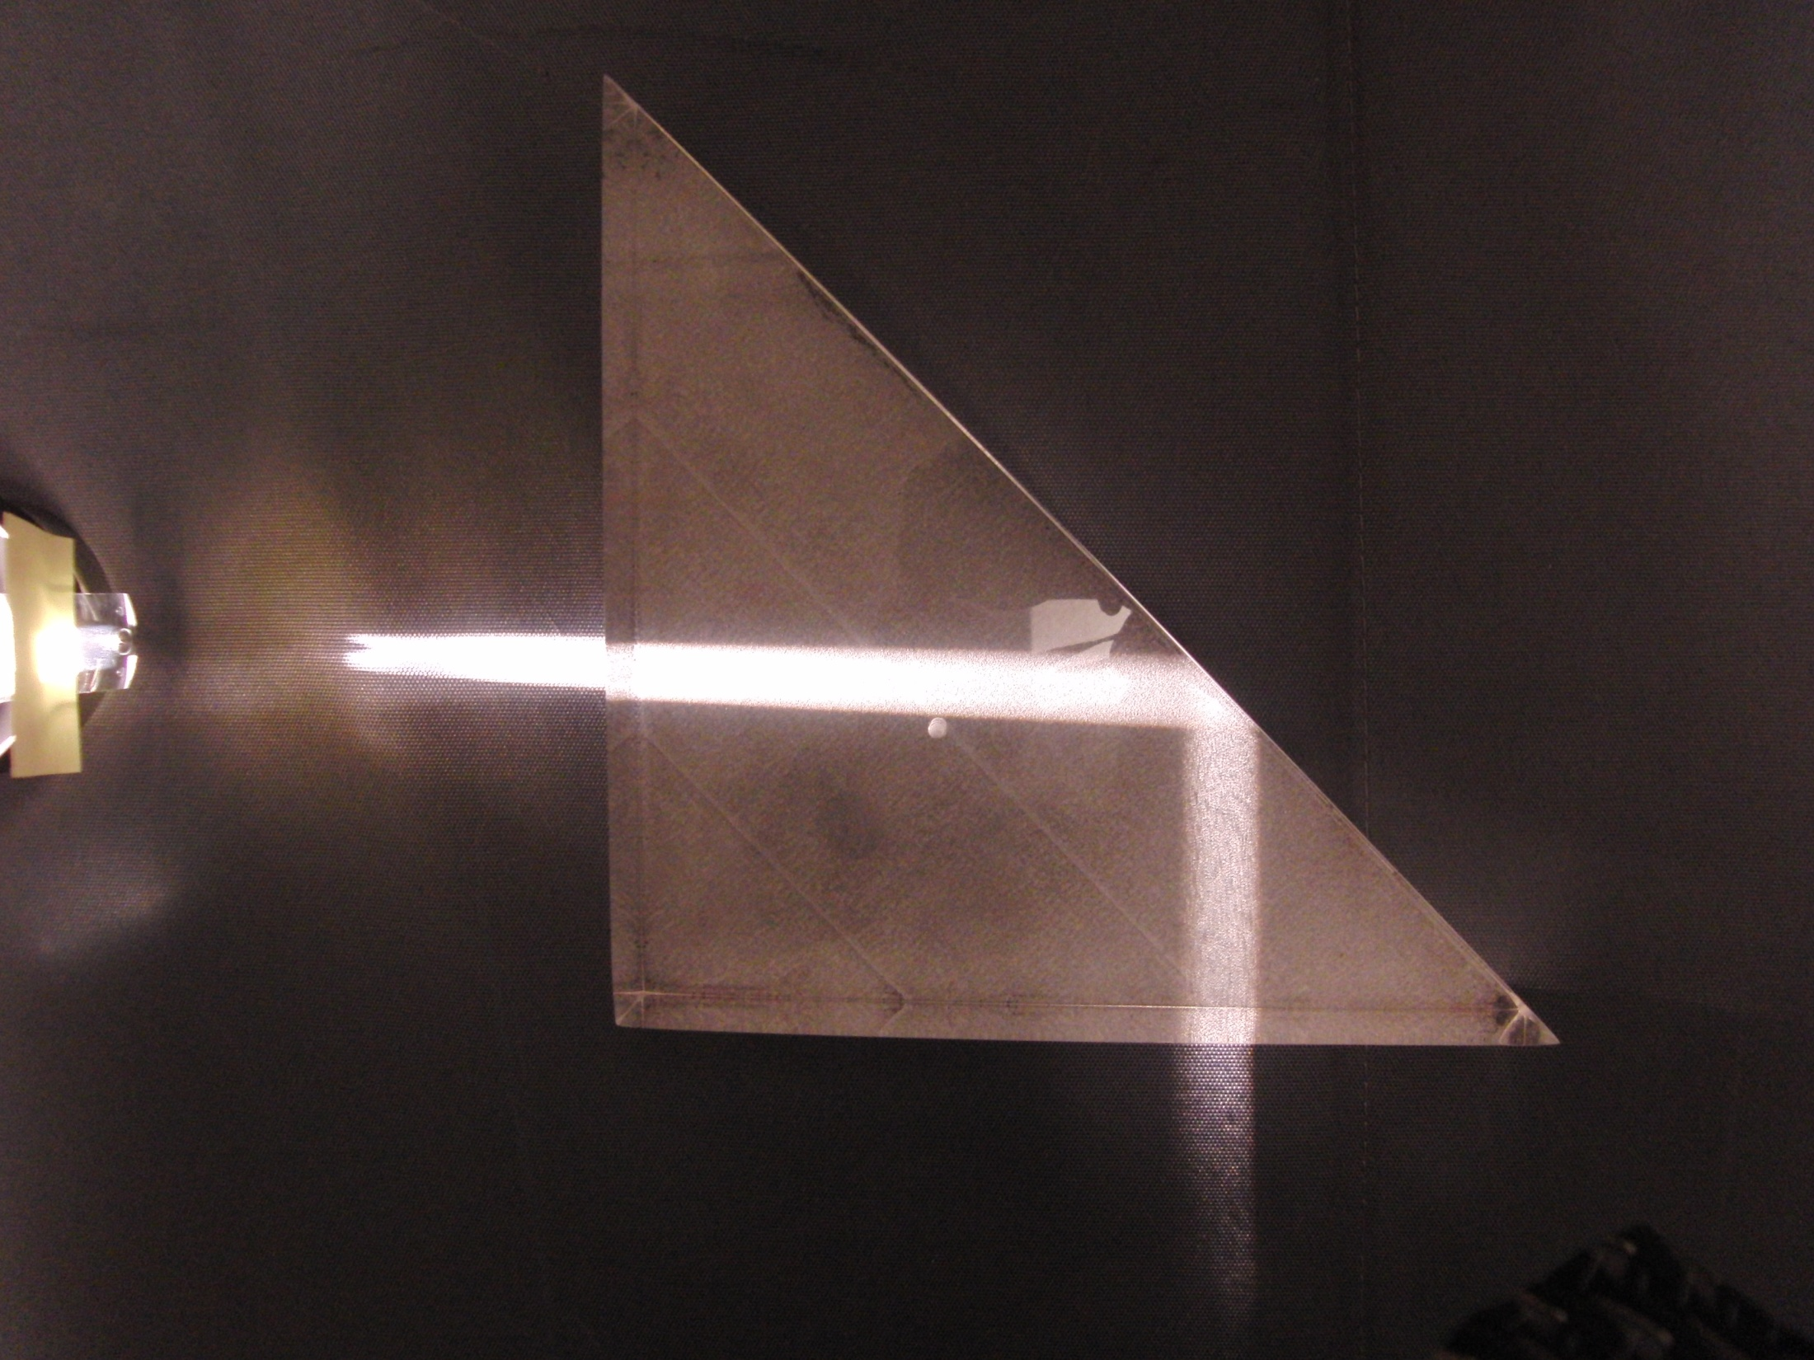

Slide 23
θ_{t}
θ_{c}
θ_{i}

Slide 24
Fast
n₂ (Small)
Slow
n₁ (Large)
θ_{c}
Source

Slide 25
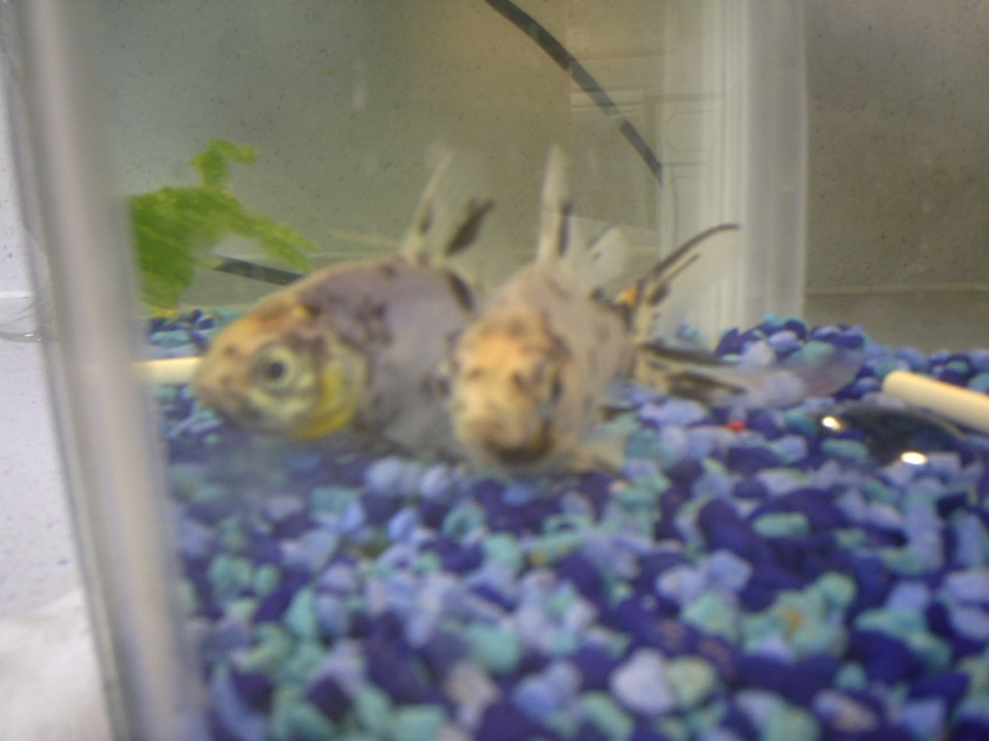

Slide 26
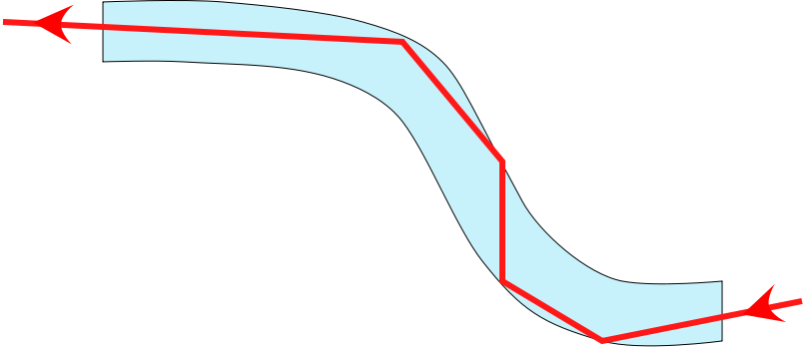
Fiber Optics
An application of internal reflection
Plastic or glass rods are used to “pipe” light from one place to another
Applications include:
medical use of fiber optic cables for diagnosis and correction of medical problems
Telecommunications

Slide 27
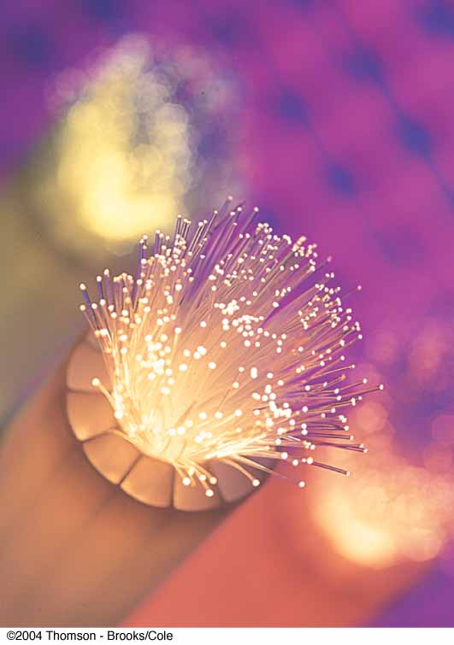
Fiber Optics, cont.
A flexible light pipe is called an optical fiber
A bundle of parallel fibers (shown) can be used to construct an optical transmission line

Slide 28
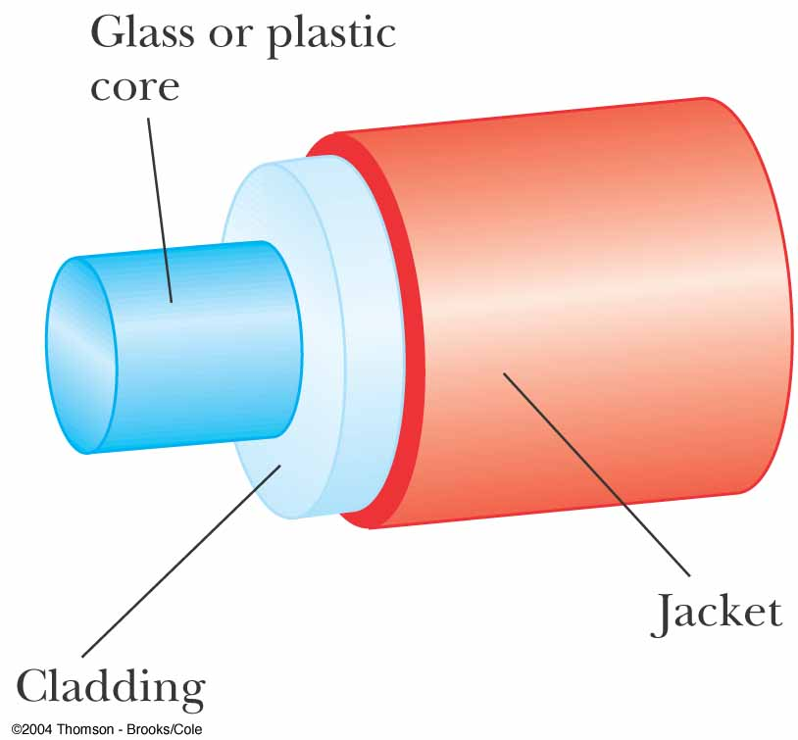
Construction of an Optical Fiber
The transparent core is surrounded by cladding
The cladding has a lower n than the core
This allows the light in the core to experience total internal reflection
The combination is surrounded by the jacket

Slide 29
Question 223.14.7
You are on a boat, and you are watching a night diving expedition. The divers carry powerful flashlights. To you, each flashlight beam seems to be a dispersed set of small lights. Why?
The light must come from many flashlights to seem to come from more than one spot
The light is sometimes reflected due to total internal reflection and sometimes not because of the surface waves
The light is blocked by fish and other sea life
Can’t even guess

Slide 30
Question 223.14.8
You are fishing and wish to catch a big one. You want to sneak up on the fish. Can the fish see the shore line?
It depends on where the fish is relative to you and the angle you subtend from the horizontal
No, fish cannot see out of the water due to total internal reflection
Fish can see the shore line, but it can see things overhead better.
It depends on what color you are wearing. The water causes dispersion

Slide 31
Question 223.14.9
You are building a complex optical device on an optical bench. You are out of mirrors. Can you use a prism instead?
Yes
No
Maybe

Slide 32
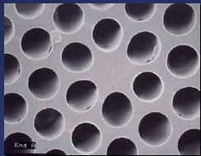
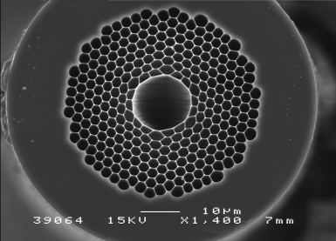
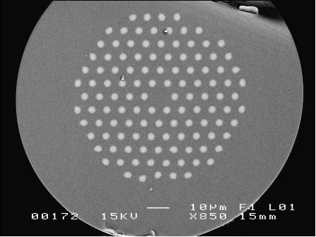
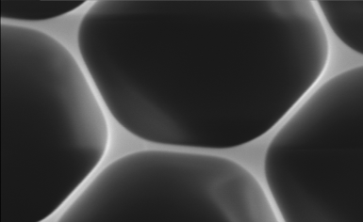
Modern Hollow-Core Fibers
Figure 2. Solid photonic bandgap fibre with isolated high-index cladding rods and a low-index core..
Figure 1. Hollow-core photonic bandgap fibre for guiding 1064nm light (above) and close-up of the bandgap cladding material (below).

Slide 33
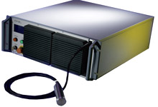
Example: Fiber Lasers
IPT Photonics YLR- LP Series: 10 to 500W Single Mode Linearly Polarized Ytterbium Fiber Lasers
Main Features:
1060 to 1070nm Wavelength Range
Extinction Ratio &gt;20dB
TEMoo (M2&lt;1.1)
Air or Water Cooled Versions
100,000 hours Est. Pump Diode Lifetime
Maintenance Free Operation
Single Mode Fiber Delivery
Applications:
Materials Processing
SHG
Medical
Scientific

Slide 34
END

Slide 37
Holography
Beam Splitter
Mirror)
Light from laser expanded with beam expander
Interference Pattern
(Hologram)
Object

Slide 38
Holography Reconstruction
Mirror)
Light from laser expanded with beam expander
Interference Pattern
(Hologram)
Reconstructed Image of Object

Slide 39
Diffraction of X-Rays by Crystals
X-rays are electromagnetic waves of very short wavelength
Max von Laue suggested that the regular array of atoms in a crystal could act as a three-dimensional diffraction grating for x-rays

Slide 41
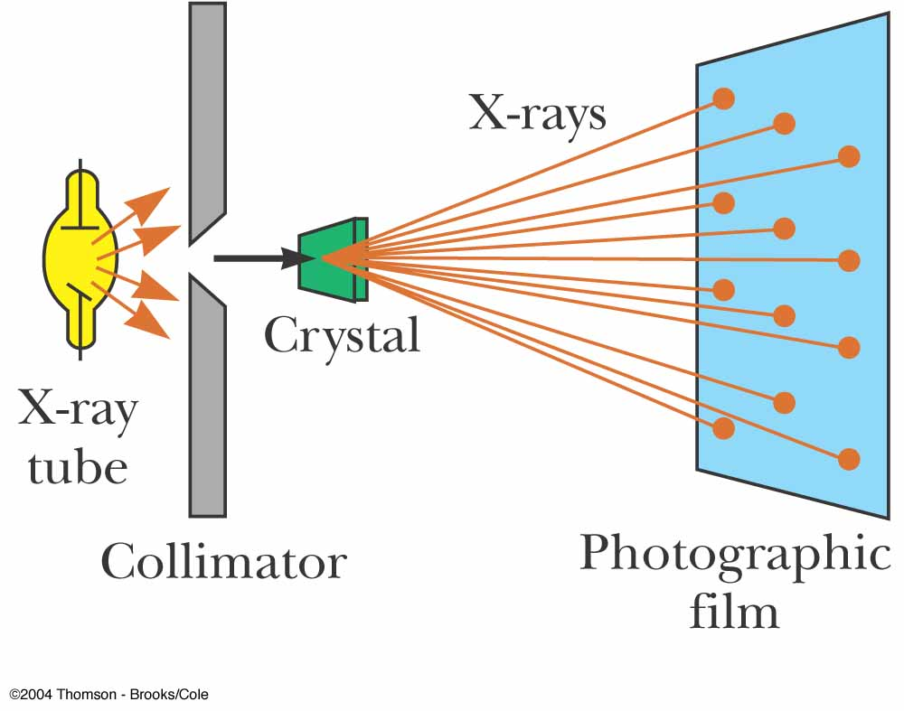
Diffraction of X-Rays by Crystals, Set-Up
A collimated beam of monochromatic x-rays is incident on a crystal
The diffracted beams are very intense in certain directions
This corresponds to constructive interference from waves reflected from layers of atoms in the crystal
The diffracted beams form an array of spots known as a Laue pattern

Slide 42
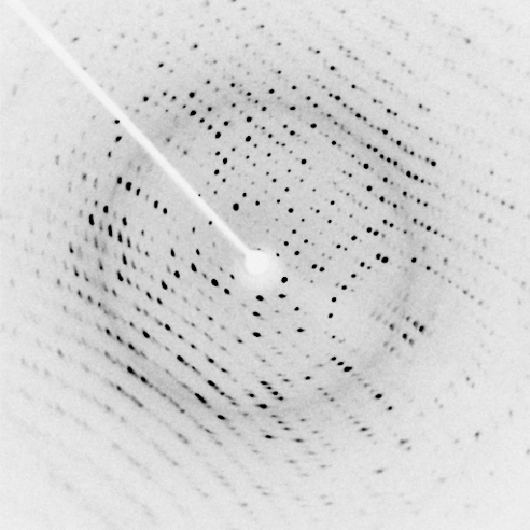

Slide 43
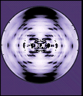

Slide 44
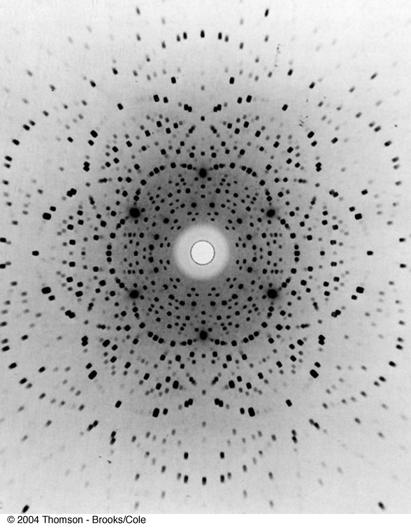
Laue Pattern for Beryl

Slide 45
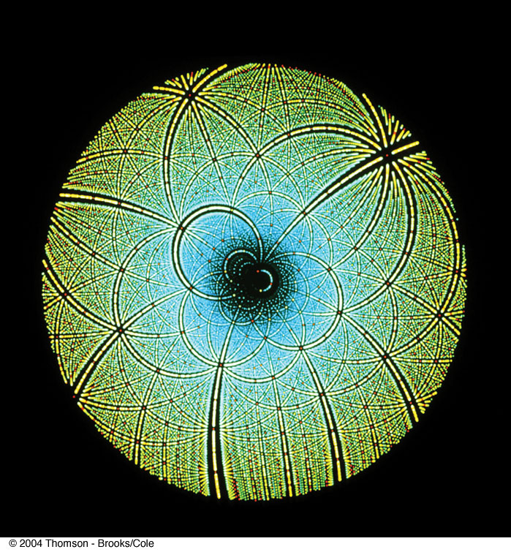
Laue Pattern for Rubisco

Slide 46
Question 223.12.3
I have a circular aperture illuminated by a laser. The aperture Diameter is E and the light that passes through the slit lands on the screen, a distance L away. If the aperture size increases, the size of the central spot will
Increase
Decrease
Stay the same
Impossible to tell

Slide 47
Question 223.12.4
I have a laser pointer with a wavelength of 632nm and a beam profile that is about half a millimeter across. I shine it through a circular aperture with a diameter of 1m. About how big is the central spot on a screen 10m away?
6.1683 x 10⁻⁶m
A few millimeters
Maybe a centimeter or two
About a meter

Slide 48
Question 223.13.0.6
I have radar waves (λ = 3.2cm) that illuminate a circular aperture with diameter of 2mm. Will the wave nature of light be important?
Yes
No
Maybe

Slide 49
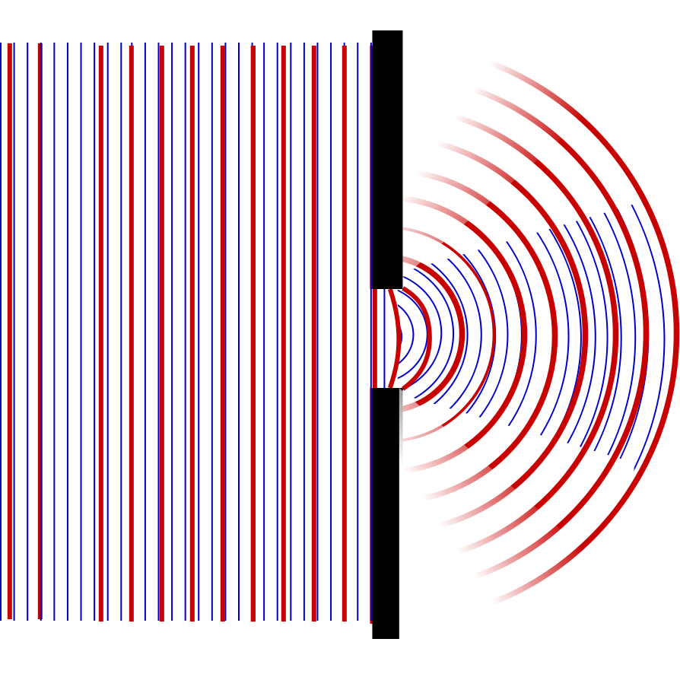

Slide 50
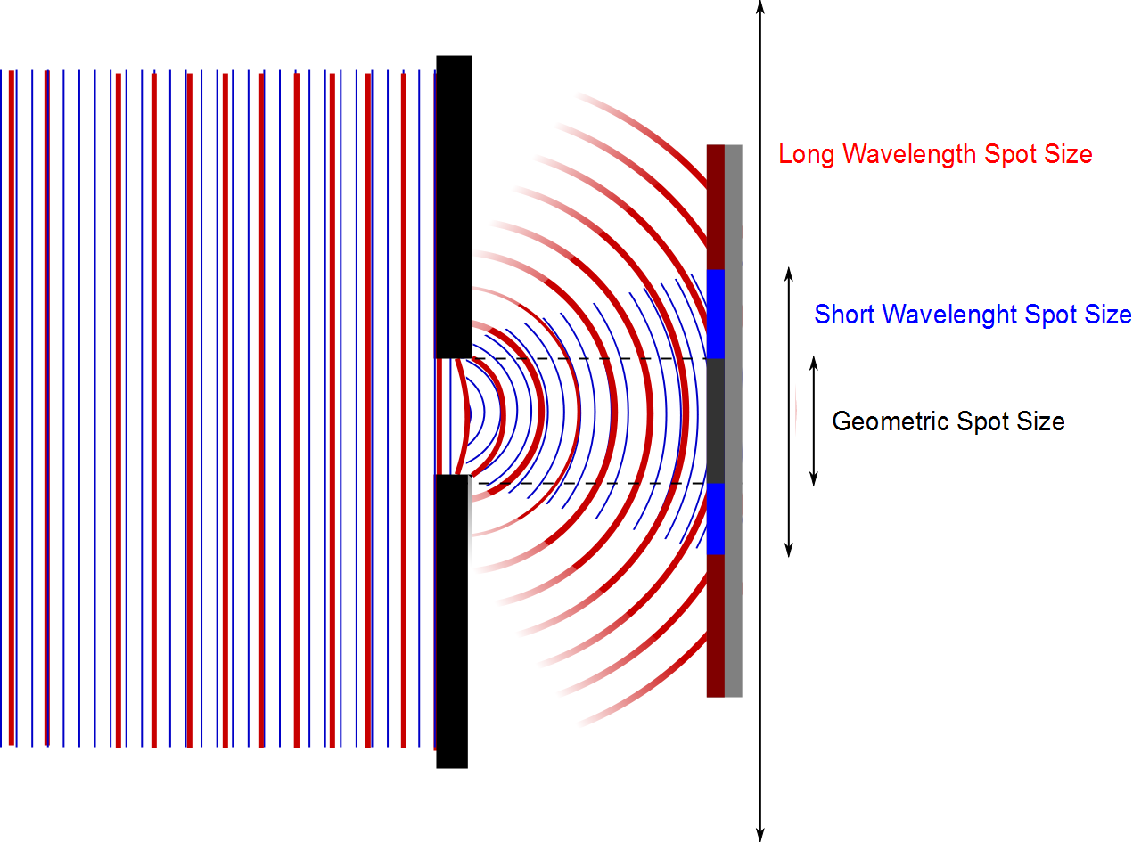

Slide 51
Question 223.13.0.5
I have radar waves (λ = 3.2cm) that illuminate a circular aperture with diameter of 2m. Will the wave nature of light be important?
Yes
No
Maybe

Slide 52
Question 223.13.0.7
I have radar waves (λ = 3.2cm) that illuminate a circular aperture with diameter of 3.2cm. Will the wave nature of light be important?
Yes
No
Take another physics class to find out

Slide 53
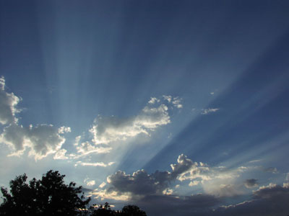
Question 223.13.1
You are in the western US and you observe a dramatic sunset. The Sun is descending through a bank of clouds and you see light and dark bands . What is causing these?
Constructive and Destructive Interference from the light traveling through small slits in the mountains
Constructive and Destructive Interference from the light traveling through small openings in the clouds
The dark bands are cloud or mountain shadows
Crepuscular rays: Image public domain http://commons.wikimedia.org/wiki/File:Crepuscular_rays.jpg

Slide 54
Question 223.13.1.5
If I take two light bulbs near each other, will I observe interference where the light from the bulbs meet?
Yes
No

Slide 55
Question 223.13.2
Will light from two sources that starts in phase necessarily stay in phase?
Yes, if the initial phase is the same, the light will stay in phase
No, the light might have different wavelengths, which will cause the phase to diverge
No, The light might take different paths, which would cause a relative phase

Slide 56
Question 123.13.3
Which of the following would likely be a coherent source?
Laser
Light bulb
Glow stick
Radio transmission
Black body emission

Slide 57


